Slide 1
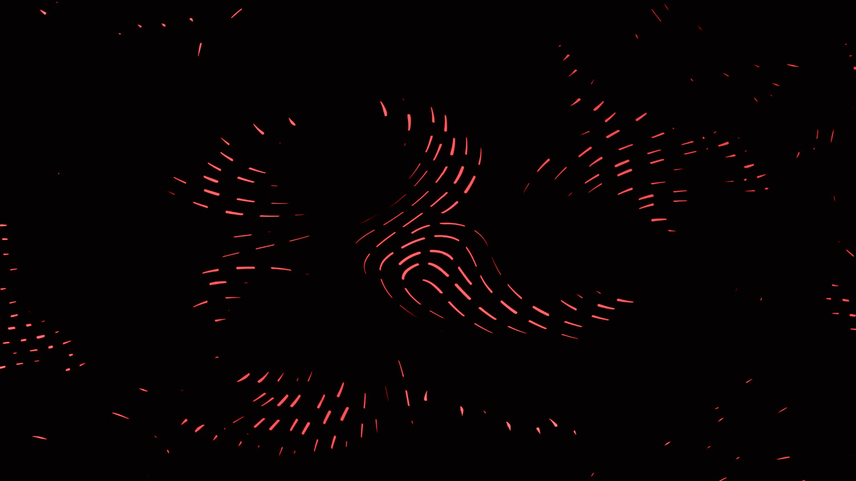

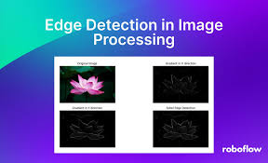
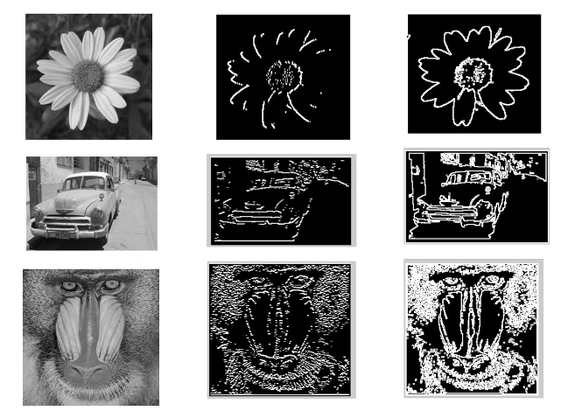
Edge Detection using Sobel and Prewitt Operators: Applications in Image Processing
•NAME –
•UNIVERSITY ROLL NO:
•PAPER NAME : Computer Vision
•PAPER CODE : PEC-AIML 701B
•SEMESTER/YEAR : 7TH SEM/ 4th YEAR •DEPARTMENT :CSE(AI&ML)

Slide 2
Fundamentals of Edge Detection
The early stages of vision processing identify features in images that are relevant to estimating the structure and properties of objects in a scene.
Edges are one such feature. Edges are significant local changes in the image and are important features for analyzing images.
Edges typically occur on the boundary between two different regions in an image.
There are three types of edges: Horizontal edges, Vertical edges, Diagonal edges
Edge detection is frequently the first step in recovering information from images. Due to its importance, edge detection continues to be an active research area.
What is Edge Detection?
A technique used to identify points in a digital image where the image brightness changes sharply.
Crucial for identifying object boundaries, texture, and structure in images.
Why is it Important?
Essential for various higher-level image processing tasks such as object recognition, 3D reconstruction, and scene understanding.
Edge detection is a fundamental technique in computer vision and image processing, enabling the identification of object boundaries and enhancing image analysis.

Slide 3
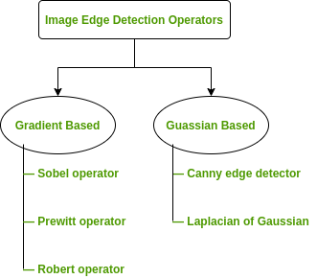
Mathematical Foundation
Edge Detection Operators are of two types:
Gradient – based operator which computes first-order derivations in a digital image like, Sobel operator, Prewitt operator.

Slide 4
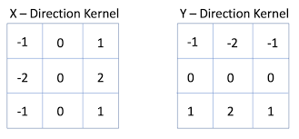
Sobel Operator: Theory and Methodology
Sobel Operator:
It is named after Irwin Sobel.
It is a discrete differentiation operator.
It computes the gradient approximation of image intensity function for image edge detection.
At the pixels of an image, the Sobel operator produces either the normal to a vector or the corresponding gradient vector.
5. It is used to detect two kinds of edges in an image:
Vertical direction
Horizontal direction
It uses two 3 x 3 kernels or masks which are convolved with the input image to calculate the vertical and horizontal derivative approximations respectively –
The Sobel operator is the magnitude of the gradient computed by .
M = √Sx^2 + Sy^2
where the partial derivatives are computed by
Sx = (a2 + ca3 + a4) - (ao + ca7 + a6)
Sy = (ao + ca1 + a2) - (a6 + ca5 + a4) with the constant c = 2. Like the other gradient operators, Sx and Sy can be implemented using convolution masks:

Slide 5
Sobel Operator Method
How it Works:
Combines smoothing (via convolution with a Gaussian filter) with differentiation.
Emphasizes regions of high spatial frequency.
Steps in Sobel Edge Detection:
Step 1: Convert image to grayscale.
Step 2: Apply Sobel filter in horizontal (Gx) and vertical (Gy) directions.
Step 3: Compute gradient magnitude and orientation.
Step 4: Apply thresholding to highlight edges.
Applications:
Used in tasks requiring more pronounced edges, such as road detection in self-driving cars.
Advantages:
Simple and time efficient computation
Very easy at searching for smooth edges
Limitations:
Diagonal direction points are not preserved always
Highly sensitive to noise
Not very accurate in edge detection
Detect with thick and rough edges does not give appropriate results

Slide 6
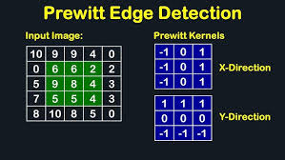
Prewitt Operator: Theory and Methodology
The Prewitt operator was developed by Judith M. S. Prewitt.
The Prewitt operator is another first-order edge detection algorithm, similar to the Sobel operator, that computes the gradient of the image intensity function.
Methodology:
Prewitt uses two 3x3 kernels, one for horizontal and one for vertical gradient calculation. The resulting gradient magnitude and direction are used to identify edges.
The Prewitt operator uses the same equations as the Sobel operator, except that the constant c = 1
How it Differs from Sobel:
Uses simpler 3x3 convolution kernels.
Less computationally intensive, but also less accurate in detecting diagonal edges.
Prewitt filters typically offer faster computation.

Slide 7
Prewitt Operator Method
Steps in Prewitt Edge Detection:
Step 1: Convert image to grayscale.
Step 2: Apply Prewitt filter in horizontal (Px) and vertical (Py) directions.
Step 3: Compute gradient magnitude using a similar approach to Sobel.
Step 4: Apply non-maximum suppression to thin out edges.
Applications:
Preferred in real-time applications where speed is critical, such as video surveillance.
Advantages:
Good performance on detecting vertical and horizontal edges
Best operator to detect the orientation of an image
Limitations:
The magnitude of coefficient is fixed and cannot be changed
Diagonal direction points are not preserved always

Slide 8
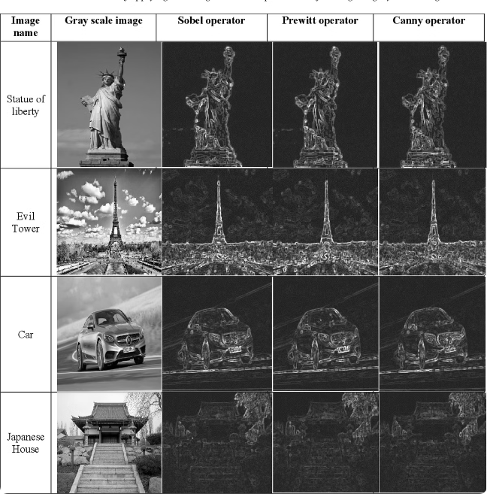

Comparison of Sobel and Prewitt Operators
1
Computational Complexity
Sobel is slightly more computationally intensive due to its use of squares in the gradient calculation.
2
Noise Sensitivity
Use Cases:
Sobel: Better for high-quality edge detection in still images.
Prewitt: Suitable for real-time edge detection in videos or scenarios with constrained resources.
Sobel is generally more robust to noise due to its use of squares, which amplifies the gradient response.
3
Edge Detection Accuracy
Both operators perform well, but Sobel may be slightly more effective in certain scenarios, such as detecting weak edges.

Slide 9
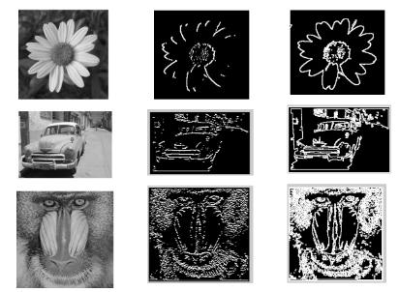




Applications of Edge Detection in Image Processing
Object Detection
Image Segmentation
Feature Extraction
Image Enhancement
Edge detection helps identify object boundaries, enabling more accurate object recognition and segmentation.
Edges can be used to partition an image into meaningful regions, facilitating higher-level image analysis.
Edges are critical for identifying and extracting visual features, such as lines, shapes, and textures.
Edge detection can be used to sharpen images, improve contrast, and highlight important details.

Slide 10



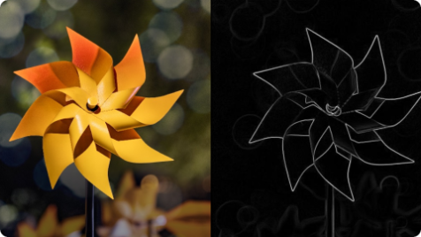
Conclusion and Future Directions
Key Takeaways
Future Advancements
Expanding Applications
Edge detection is a fundamental technique in computer vision, with Sobel and Prewitt being two widely used operators for their effectiveness and efficiency.
Ongoing research aims to develop more robust and adaptive edge detection algorithms, incorporating deep learning and other advanced techniques.
Edge detection will continue to play a crucial role in a wide range of image processing and computer vision applications, from autonomous driving to medical imaging.
THANK YOU

